Slide 1
Item/doc 8.5/(3) – TT-Hydrology recommendations
Third Session of the Infrastructure Commission
(INFCOM-3, 15-19 April 2024)
Jan Danhelka/Chair TT-Hydro
18 April 2024

Slide 2
WMO’s activities in operational Hydrology
WMO supports countries to develop and strengthen data, information, capacities and services across the entire hydrological value cycle through National Hydro-meteorological Services and other partners, in order to address growing water challenges: flood, droughts, drinking water, agriculture, navigation, hydropower, ecosystems, tourism, …
WMO eight long-term ambitions on water (Cg-EXT (2021)
No one is surprised by a flood
Science provides a sound basis for operational hydrology
Everyone is prepared for drought
We have thorough knowledge of the water resources of our world
Hydro-climate and meteorological data support the food security agenda
Sustainable development is supported by information covering the full hydrological cycle
High-quality data supports science
Water quality is known

Slide 3
WMO's work along the Hydrological Value Chain
Enhancing water monitoring systems
Strengthening national capacities in basic observation, fostering basin-wide, regional and international cooperation and promoting the free exchange of hydrological data and information
Facilitating interoperable hydrological data sharing
Helping produce standardized information on the current state of the water resources and forecast the situation for the next days or months
User-Feedback
and support
Real time monitoring, data collection, storage & sharing
Services &
decision support
Capacity Development
& Science
Modelling &
forecasting
Strengthening Flood and Drought Forecasting
Delivering improved forecasts and warnings of severe weather
Facilitating the development of efficient forecasting and warning systems for coastal inundation (often combined with riverine flooding)
Helping produce standardized information on the current state of the water resources and hydrological outlooks
Information
Dissemination
Product
Development
Assessing water resources and supporting water security​​
Minimizing loss of life from flooding
Building climate resilience, reducing economic and social losses, and alleviating poverty in drought-affected regions
INFCOM

Slide 4
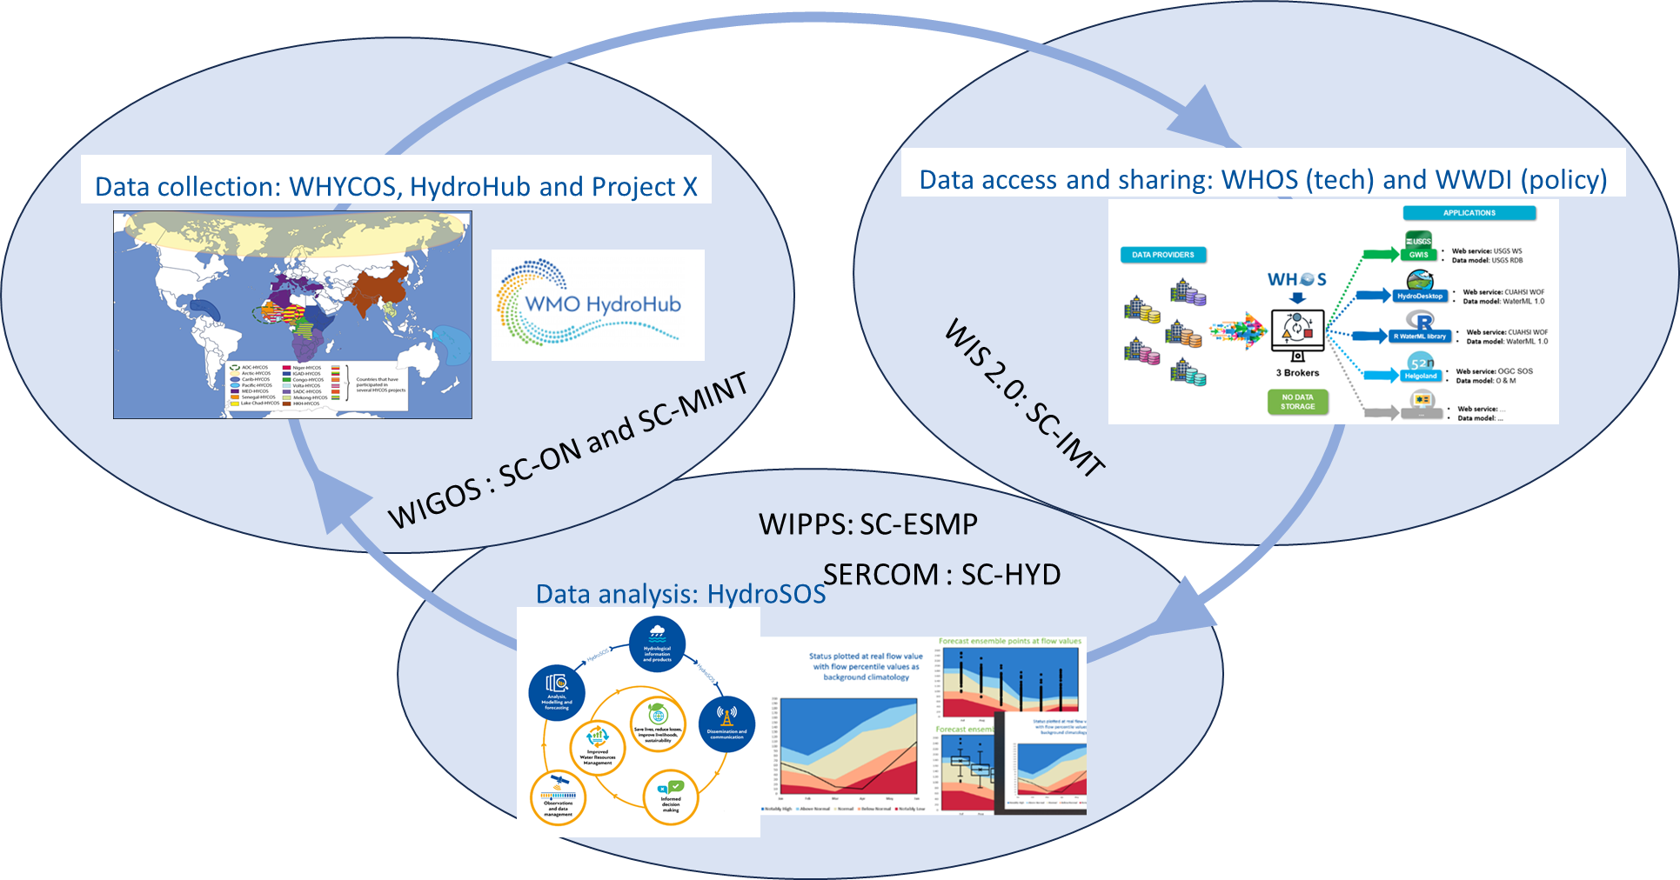
Hydrology monitoring is across all Standing committees
After 4 years, need for better mechanism for aligning activities
Notes:
Dom

Slide 5
Task Team Hydro
Interdisciplinary group established Summer 2023, broad representation from Standing Committees, hydrological community, Regional Associations
Focus on structure and integration
DOC with Decision and TT Hydro report with 8 recommendations
INF doc with full analysis and suggested additional tracks to explore

Slide 6
Main recommendations
Establishing an Advisory Group on Hydrology
Co-design of INFCOM goals and activities with all communities
Communication material
INFCOM to invite PR to nominate Hydro experts for work and events
SCs encouraged to secure hydro experts at SC level
JET-HYDMON to be disbanded, all technical hydrological activities under ETs or TTS from SCs.
To disband TT Hydro
Tool development to monitor success of AG Hydrology

Slide 7
Suggested structure
INFCOM MG
Coordination and value chain
AG-HYDRO
JET- HYDMON
Technical work (Project X, innovation, sediment, …)
ET-H1
ET-H2
SC-MINT
SC-ON
SC-IMT
SC-ESMP
Technical work (WHYCOS, HydroHub, HydroSOS, RRR, … )
SG 1
Technical work (WHOS )
ET-H3
ET-H4
Technical work (HydroSOS, …)
note: there already are an Advisory group on GCW and one on Ocean, and one for GHG has been submitted

Slide 8
Term of References (TORs) of AG Hydrology (1/2)
Is under INFCOM Management Group
Similar TORs for all Advisory Groups (with specific points though)
Coordination, advice, advocacy, no technical work
Up to 15 experts, less would be better.
Term of references:
Act as the entry point for hydrological observing infrastructure, data and information systems and predictions, including advocacy for Earth System approach benefits and increased expert participation;
Advise the management group on hydrological monitoring related matters by translating the needs from and for the hydrological community, gathered through the Hydrological Coordination Panel (HCP), into suggested activities of INFCOM bodies;
(c) Oversee, coordinate and monitor the implementation of the infrastructure aspect of the Plan of Action for Hydrology, in coordination with Hydrological Coordination Panel;

Slide 9
TORs of AG Hydrology (1/2)
Advise the management group and standing committees on the optimal working structure and engagement of domain experts to address specific deliverables required by the Plan of Action, promoting the integration of observing systems, data exchange and management and prediction functions into WIGOS, WIS and WIPPS, while ensuring the necessary coordination within domain experts;
Advise the management group and assist the vice-president representing the domain on engagement, through HCP, with the regional associations, the Services Commission, and relevant external partners to share information on requirements, workplans, and deliveries to preserve the value cycle in specific infrastructure components of the hydrological domain;
(f) Work with the Panel on Capacity Development of the Executive Council, through the Coordinator on Capacity Development, on capacity development including training.

Slide 10
Draft decision
To approve the final report of the Task Team Hydrology (TT-Hydro) and its recommendations, noting that recommendation on establishing an Advisory Group on Hydrology is handled under draft Resolution 6.2 (INFCOM-3);
To request the Management Group of the Commission for Observation, Infrastructure and Information Systems and Standing Committees to implement relevant recommendations;
To request the president of the Commission for Observation, Infrastructure and Information Systems to consult with the president of the Commission for Weather, Climate, Hydrological, Marine and Related Environmental Services and Applications and to engage with stakeholders as needed in order to develop and implement relevant recommendations.

Slide 11
Comments received
Annex 1 to draft Decision 8.5(3)/1 (INFCOM-3)
P. 4, Challenges for INFCOM HYDROLOGY, 3d bullet:
• Community division: Remaining "us and them" perceptions among different disciplinary communities, due, among other, by the fact that in some Member countries the responsibilities for meteorology and hydrology do not fall in the remit of the same organization, [Spain] may hamper collaboration and cohesion within INFCOM and other WMO bodies (e.g., the Commission for Weather, Climate, Hydrological, Marine and Related Environmental Services and Applications (SERCOM), the Research Board (RB).

Slide 12
Thank you.
^{wmo.int}

